Slide 1
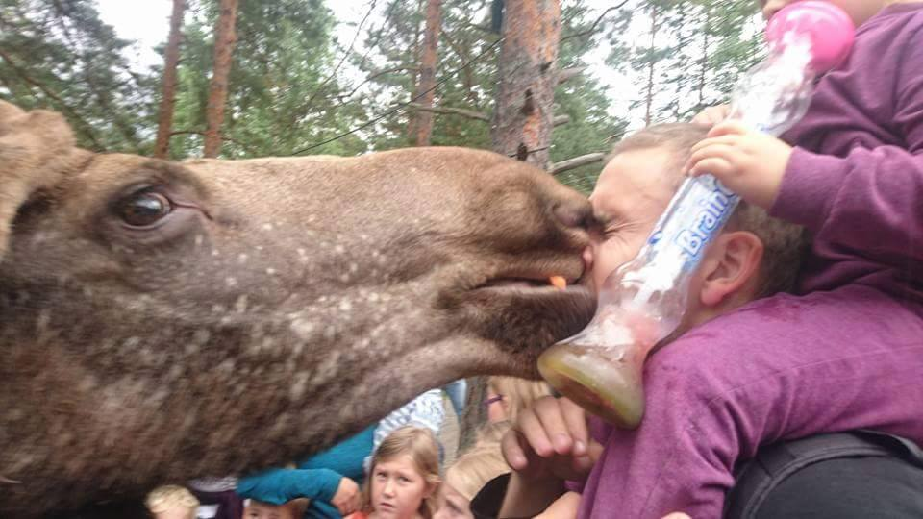

Deep-dive Microsoft 365 CoPilot and Azure OpenAI
Marius Sandbu
Cloud Evangelist – Sopra Steria Norway
Slides + Demos + LLM Ecosystem
https://github.com/msandbu/gpt-ai
https://msandbu.org/the-current-state-of-generative-ai-and-llms/

Slide 2
Let´s start with the LLMs

Slide 3
Generative AI
Text
Pre-trained Models
Speech
Music
Pictures
Can generate new content by looking for patterns in the existing data
Video
Code

Slide 4
Generative AI
Copilot
Pre-trained Models
Elevenlabs
Suno
DALL-E Copilot
Support for <30 different languages via text
<10 different languages via voice
OpenAI Sora
Github Copilot

Slide 5
The background of LLM’s and OpenAI
GPT-2 1.5 Billion parameters GPT-3 175 Billion parameters
GPT-4 1.7 Trillion parameters
10 tokens is close to 7 words (depending on size and complexity)
Training a language model on 70 billion parameters costs ~32 Million $
The processing power from GPT-4 compared to 3 is over 15x higher
Generating content with local LLMs 7B using CPU will yield about 450 words per minute
The GPU memory requirement for an LLM is usually 2x of the number of billions of parameters (FP16)
Improved context size GPT 3.5 4096 tokens Gemini 1.5 1000000 tokens
Generating content with local LLMs using NVIDIA H100 will yield about 45000 words per minute
More LLMs moving to use a mixture of different models (MoE) “Mixture of Experts” which GPT-4 is using

Slide 6
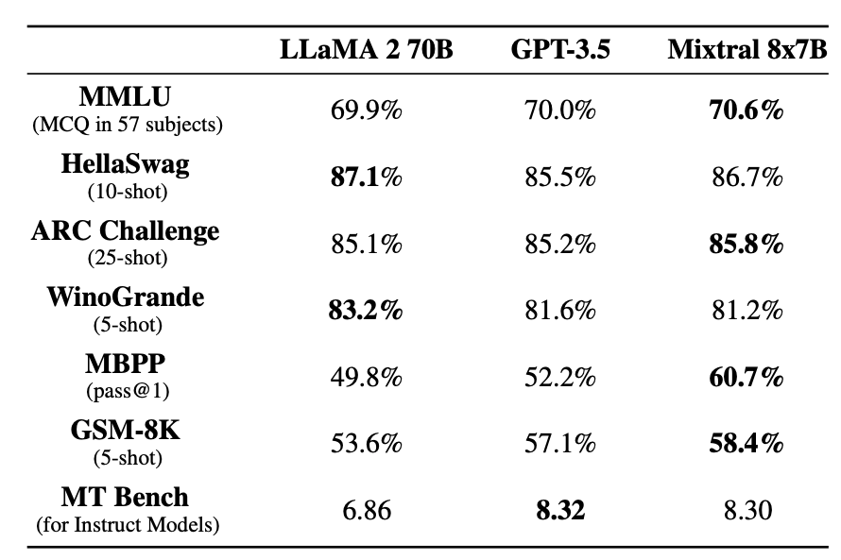
The ecosystem of Open-source LLMs
LLaMa2 (Meta) Mixtral (Mistral) Pi and Orca (Microsoft) Gemma (Google)
StarCoder2 (NVDIA, Serivce Now)
Smaug
Benchmarking LLMs and what is the best LLM? - msandbu.org

Slide 7
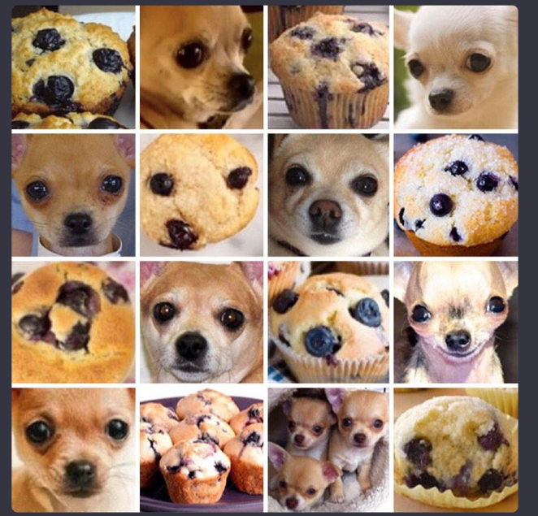
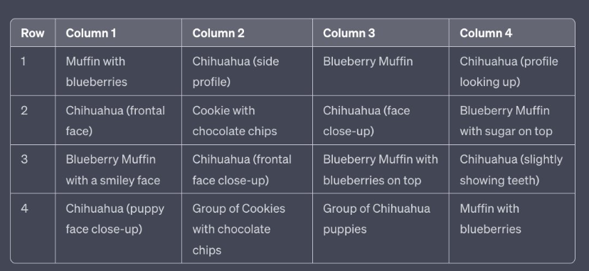
How advanced has it become?!

Slide 8

GPT 3.5 - September 2021
Context ~2500 words
GPT-4 January 2022 Context ~12000 words
GPT-4 Turbo – April 2023
Context ~100,000 words
Wikipedia (4%)
What is Expertslive?
Other archives (60%)
Training set
Encoder
Transformer Neural Network
OpenWeb Text2 (22%)
Decoder
Expertslive is a conference for IT professionals
Book Archives (16%)

Slide 9
Features from OpenAI
Codex
Whisper
DALL-E
GPT
LLM that has been used to understand and generate code. Used in GitHub copilot*
Speech-to-text used for transcribing content
Text-to-pictures Is able to understand language and create visuals
A collection of models that are able to generate output based upon prompts
TTS
GPT-V
Sora
Embedding
Text-to-speech
Picture-to-text Is able to understand context within visuals
Text-to-videoes ☺ Soon! (also Runway)
Turning data into vectors based upon relevance, similiarty and classification

Slide 10
GPT and Functions
functions = [
"name": "get_current_weather”
What is the temprature in Denmark now?
Weather info External API
JSON Code
GPT API w/functions
Weather information
LLM
Not too bad
NB: Many of the open-source models now also support functions

Slide 11

GPT Assistants (also known as Custom GPTs)
Language Model
Im good at answering questions related to NVIDIA Stocks
Data Sources
GPT w/functions
Instructions

Slide 12
Microsoft Autogen – Multiagent framework
Workflow «Create Application code»
Agent User Proxy
Agent Executive
Test Code
Language Model
Language Model
Skills
Skills
Agent Instructions
Agent Instructions

Slide 13
Language models and integration frameworks
Azure AI
LLaMa-Guard
Code LLaMa
LLaMa2-Chat
OpenAI Mistral LLaMa2
LLM created to detect if a given prompt is or response is safe/unsafe
Created on top of LLaMa2 but fine-tuned on application code
Created on top of LLaMa2 but intended for Chat based scenarios
Google Vertex
Gemini Palm Mistral
Integration frameworks and running locally
Langchain
Semantic Kernel
LlamaIndex
AWS Bedrock
Ollama
LMStudio
VMware Private AI
Claude Mistral LLaMa2 Titan
Windows AI Studio
vLLM
NVIDIA AI Workbench

Slide 14
How can we use our LLM’s with our own data?
1: Prompts
2: Fine-tuning
3: Grounding (RAG)
LLMs with our own data
Prompt Information directly into a prompt
Fine-tuning
Train the language model on your own data sources.
Prompt
Grounding (RAG)
Make data available outside the language model. Using search to retrieve relevant data

Slide 15
RAG - (Retrieval Augmented Generation)
Vector Search
LLM
Vector Database
Search
Convert data to vectors
Embeddings File ......0,1
«What is our policy on»
«This is our company policy
Text splitter
Data

Slide 16

Search is the most important part for RAG
"I like Apple the Fruit"
Full text search («apple, fruit»)
BM25 Algoritm
Vector Search (0.8, 0.2)
Hybrid Search (apple, 0.8, 0.2)
Key words and vectors
Semantic Ranking
Top results ranked after semantics
Full search first then ranked
New Embedding API from OpenAI
Document 1: «I Love eating apples»
(Vector: 0.9, 0.1)
Document 3: Fruits like apples and oranges are health»
(Vector: 0.8, 0.1)
Document 2: «Apple Inc produces popular electronics»
(Vector: 0.1, 0.9)

Slide 17
Search and vector store
Azure AI Search
Azure AI Search
Now supports Vector Search
Also supports other sources
Sharepoint, Blob Storage
FAISS (Local vector store)
MongoDB Atlas Vector Search
Vespa Search
Azure Cosmos DB
Pinecone Hybrid Search
OpenSearch
Chroma
PostgreSQL with PGVector
Index store (Text + vectors)
Hybrid Search
Example
"@search.score": 1,
"content": “ Network traffic can be fully isolated to your network",
"content_vector":
0.008099633,
-0.013640393,
0.0052737766,

Slide 18
Fine-tuning
Only supported with GPT 3.5 Turbo (GPT-4 in private private preview)
Should have atleast 1000 training samples to improve the model
Data structure needs to be in JSONL
Fine-tuned models have cost of 7$ per hour (in addition to tokens cost)
Other LLM’s support an adapter based tuning (plug and play)
Better support for SQL Queries
Better support for Norwegian
SQL-Context
NorskGPT
Fine-tuning Adapter
LLaMa2 LLM

Slide 19
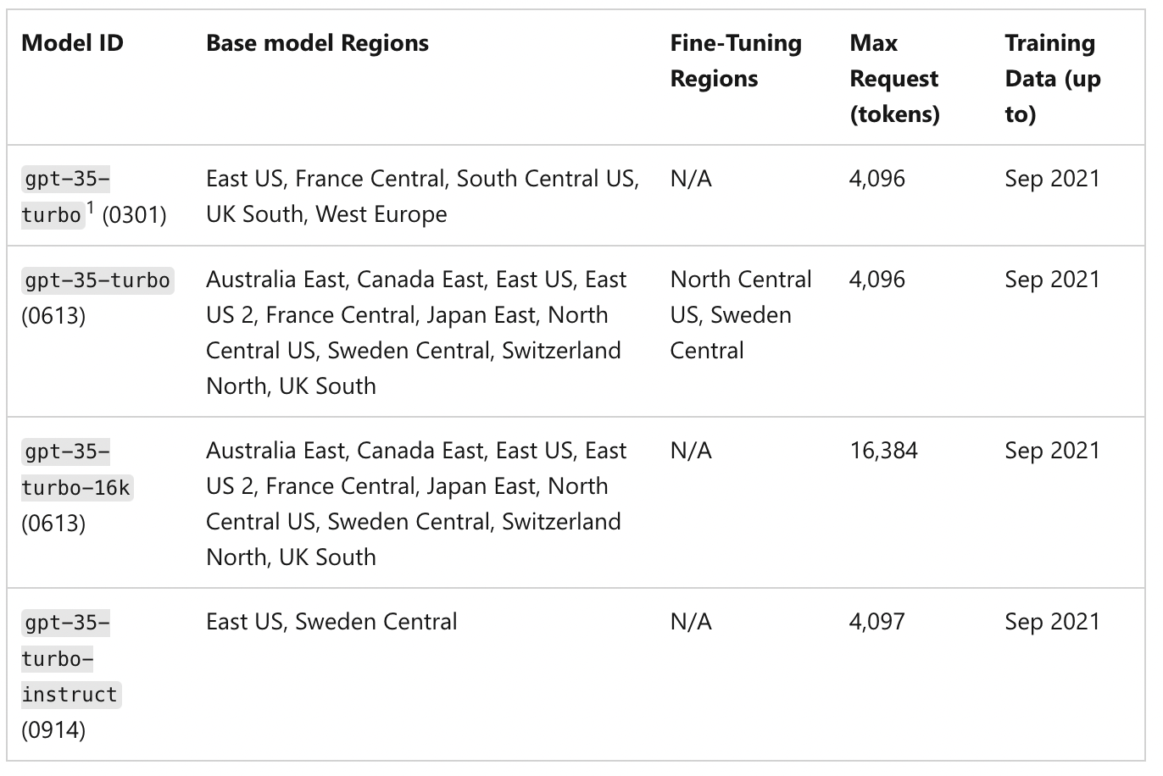
Azure OpenAI
Instruct = Model not designed for chat
Will automatically update to newer version
Can apply for 30-day logging exceptions
Pay-as-you-go or PTUs (Provisioned troughput)
Sweden Central has the most availability of the EU datacenters in terms of models and features
10x the cost for GPT 4, compared to GPT 3.5

Slide 20
Azure OpenAI
resource "azurerm_cognitive_account" "example" {
name = "example-ca"
location = var.location
resource_group_name = var.rg
kind = "OpenAI"
sku_name = "S0"
public_network_access_enabled = false
custom_subdomain_name = "example-openai2"
}
resource "azurerm_cognitive_deployment" "example" {
name = "example-cd"
cognitive_account_id = azurerm_cognitive_account.example.id
model {
format = "OpenAI"
name = "gpt-35-turbo“
version = "0301" }
scale {
capacity = 1
type = "Standard“
Only one SKU and public by default
OpenAI LLM
LLM Version
1000 tokens-per minute
Fixed version provides more a consistent response
Deploy Azure OpenAI using Terraform with Private Endpoint - msandbu.org

Slide 21
Azure OpenAI API
import os
from openai import AzureOpenAI
openai.api_base = "https://<replace with your name>.openai.azure.com"
openai.api_version = '2024-02-15-preview’
client = AzureOpenAI( api_version=api_version, azure_endpoint=endpoint, azure_ad_token_provider=token_provider, )
message_text = [{"role":"system","content":"You are an AI assistant that helps people find information."}]
client.chat.completions.create(
model="trd", # model = "deployment_name"
messages = message_text,
temperature=0.7,
max_tokens=800,
top_p=0.95,
frequency_penalty=0,
presence_penalty=0,
stop=None
Endpoint
Entra ID Auth
System Prompt
Temprature = Manages if the reply is more randomized or not

Slide 22

Custom Azure application with RAG
Azure OpenAI
Use AZD
Azure Developer CLI
Install using Winget intsall Microsoft.azd
1: Create a new folder
(to store source code)
2: azd init –t azure-search-openai-demo
3: azd auth login
4: azd env new
5: azd up
Azure AI Search
GPT Functions
PyPDF
Web App
Microsoft has many different templates that can be used as a starting point
Data
End-user

Slide 23
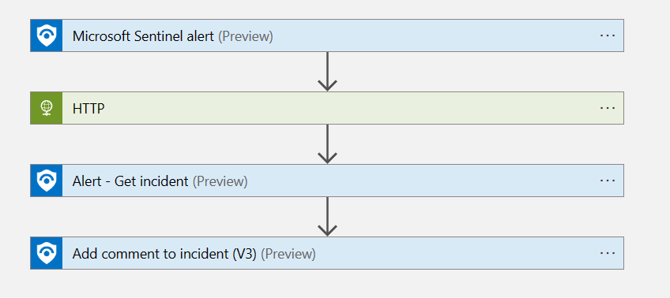
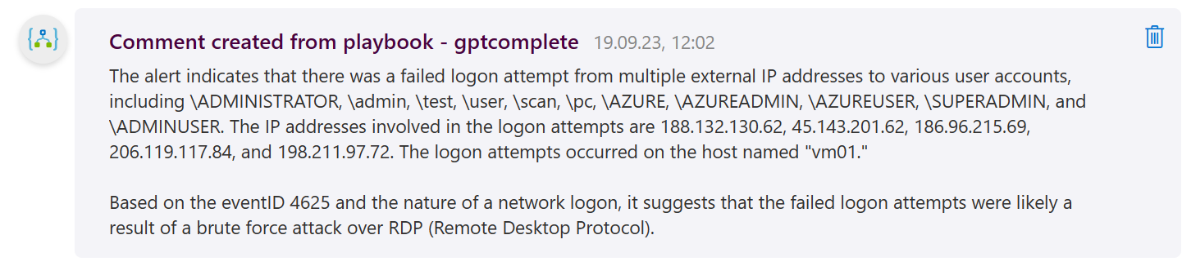
SIEM integration example
Enrichment of information Obtaining external information Automation via Azure OpenAI API

Slide 24
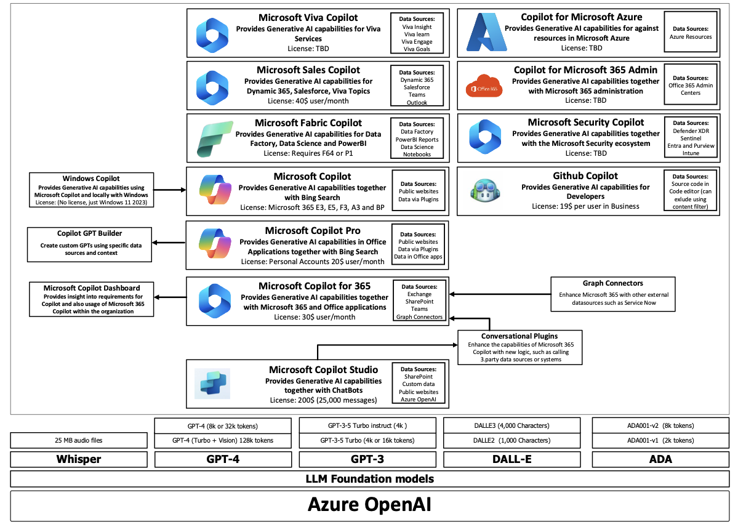
Microsoft Copilot ecosystem
All Copilot services use Azure OpenAI
Different data sources and some with RAG
Not all new OpenAI models are used by Copilot
We can extend Copilot 365 with Conversational plugins

Slide 25
Microsoft Copilot
Formerly known as Bing Chat Enterprise
Integrated into Windows and Microsoft Edge
Global Service and not bound to a region
Uses also Bing Search to find relevant content (similiar to RAG)
Uses Azure OpenAI to handle LLM processing

Slide 27
Microsoft Copilot 365
Dedicated Azure OpenAI instance for each customer
30 days logging disabled by default
Logic and prompts handled trough the Copilot Orchestrator
Under high load, LLM traffic can be handled by another region
Orchestrator uses a similiar feature like functions to do actions

Slide 28
Copilot 365
Semantic Index adds vectors to data for(RAG)
Search via the Graph API
Internet search also if feature is enabled (by default)
Can enhance capability using Conversational plugins in Copilot Studio

Slide 29
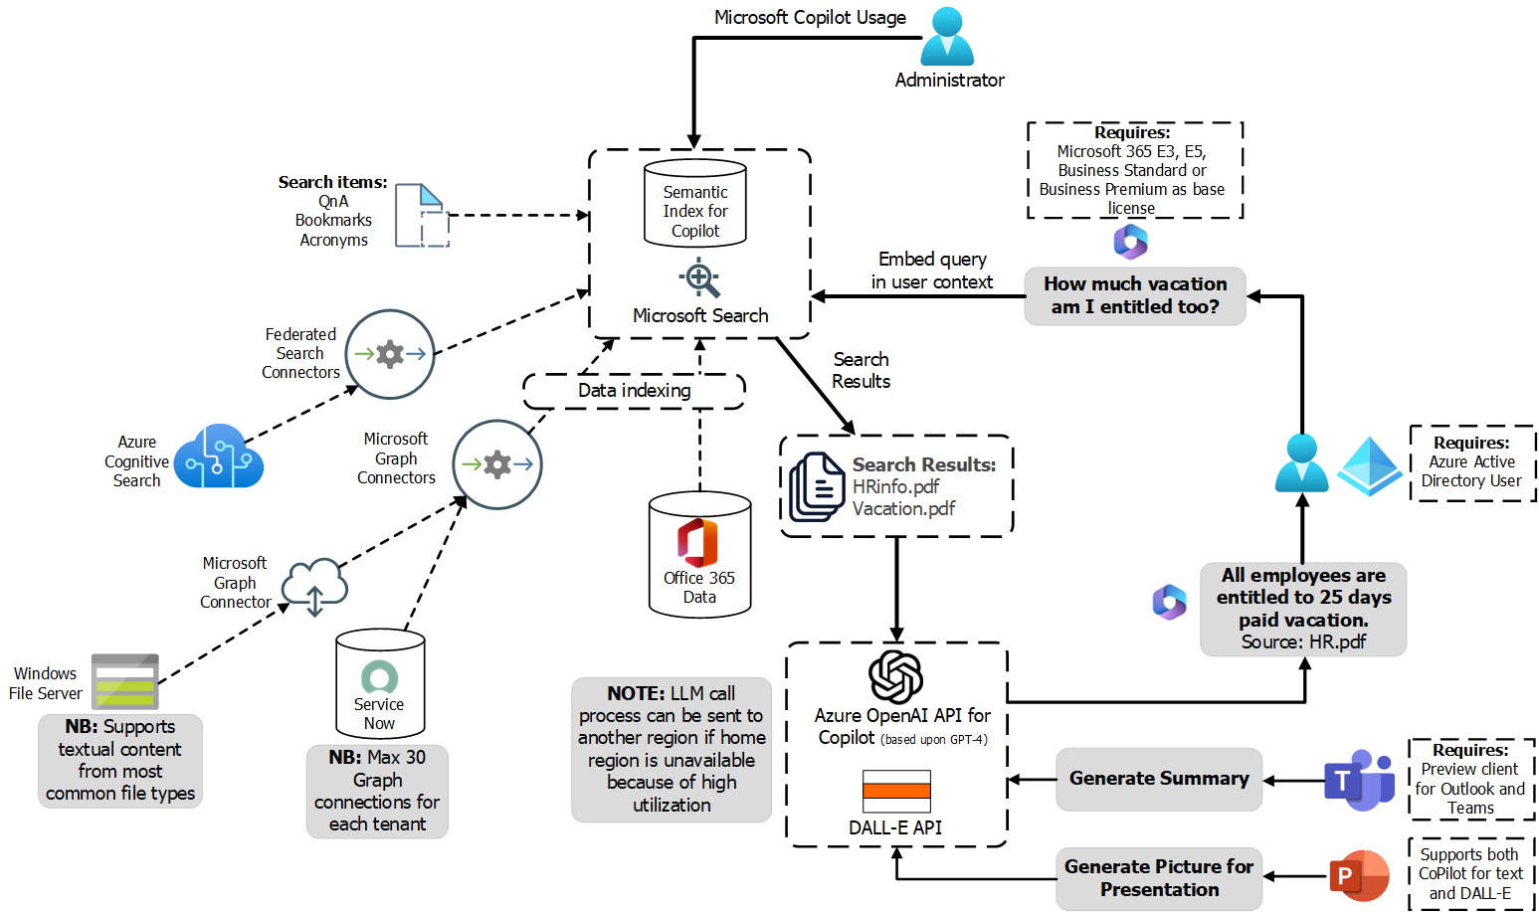

Slide 30
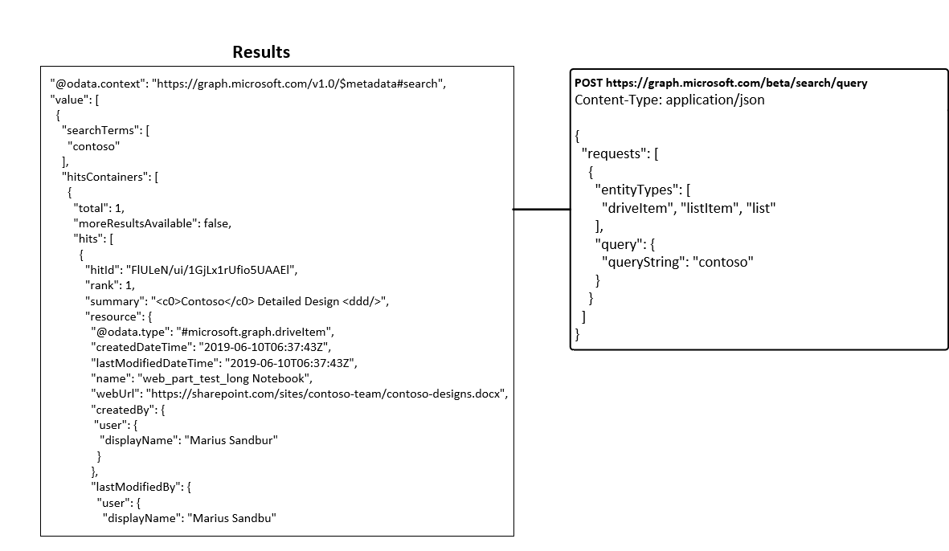
Copilot 365
Hybrid search combining vectors and key words
Search happens in context of the user
Data gets indexes for files available to you or for files that are shared with you
Semantic index and grounding info is still not available in the Graph API

Slide 31
Some of the issues
Dont have proper access control?
Search will «poison» the results
Might also get data that you shouldnt see
Limited reporting and API support
Limited language support (on the roadmap)
The LLM supports it, but functions/actions needs to as well
Data cannot be weighted in the RAG search
You need to «trust» the semantic search engine
You cannot exclude data from Copilot
NB: Except Sharepoint sites

Slide 32


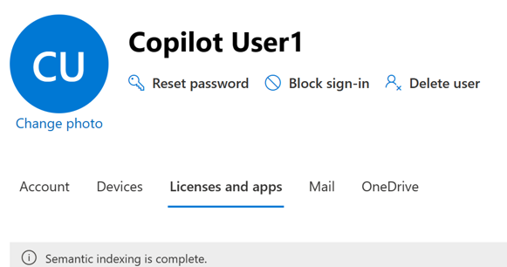
Copilot 365 and semantic index
File types supported PDF, docx, pptx, html / aspx
Indexing happens asyncronzly using a combination of vectors and keywords
Documents
Microsoft 365-Search
Upload files
Vectorize
Microsoft 365
NB: Full semantic indexing takes close to 30 days
Sources: OneDrive: User folders and recordings SharePoint sites Viva Engage-groups Email postboxes Group postboxes

Slide 33
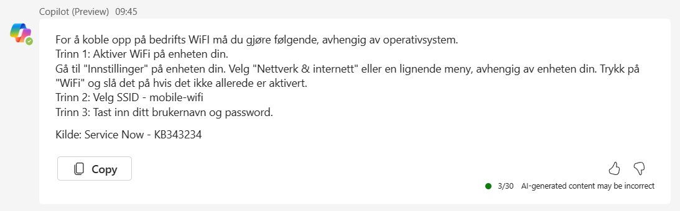

Graph Connectors with Copilot 365
Microsoft Graph Connectors
Microsoft 365 Copilot
Jira, Confluence
ServiceNow Catalog
ServiceNow Tickets
Search and get relevant sources
SQL or fileshares
«How to connect to the Wifi?»
And more..

Slide 34
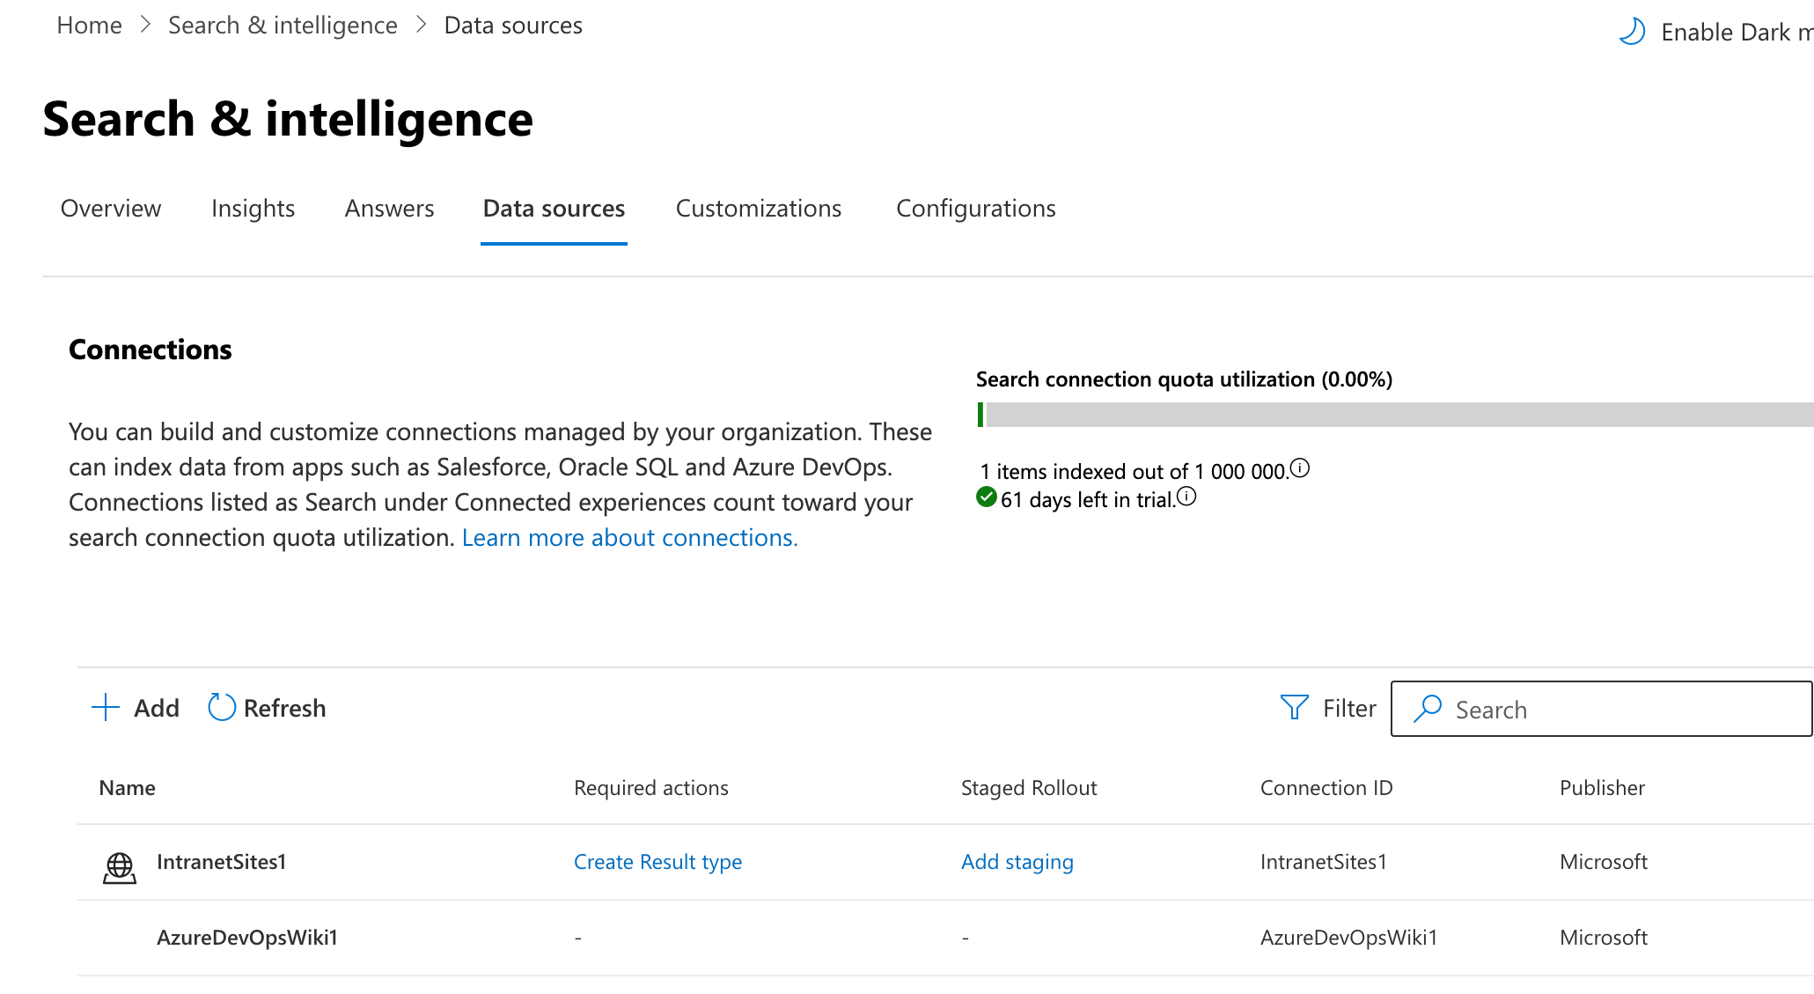
Adding custom data sources

Slide 35
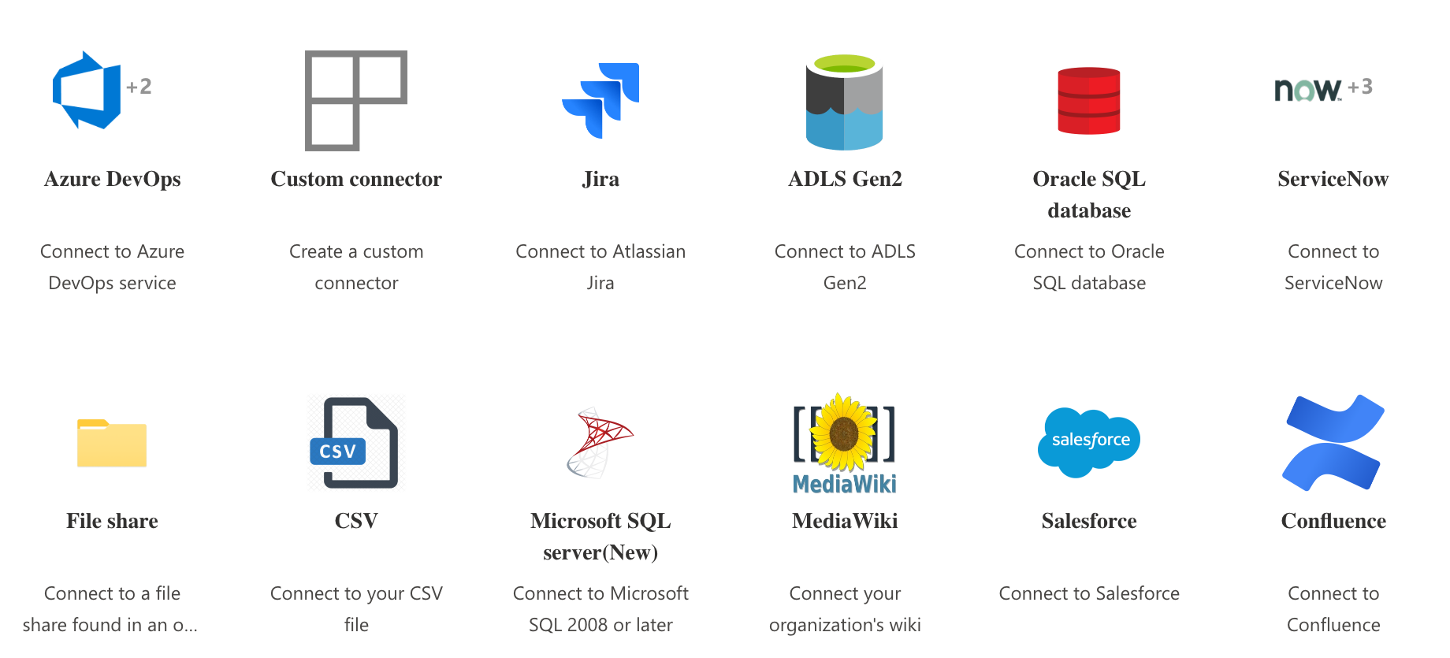
NB: Only for adding searchable content
Adding custom data sources

Slide 36
Copilot Studio
Can make custom Chatbots using generative AI
Uses its own managed Azure OpenAI instnace
Can also make plugins (actions) that can be integrated with Copilot 365
Currently in Preview

Slide 37
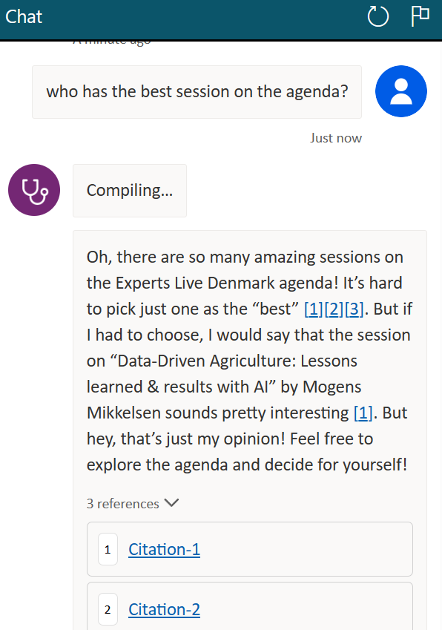
Copilot Studio
Can use data from different sources (SharePoint, Public Web, Azure AI Search, Custom files)
Define topics that should use Generative AI
Can define system prompt but cannot alter which OpenAI model
NB: Clearly some issues here
Can be published in different channels (Teams, Slack, websites and so on)

Slide 38
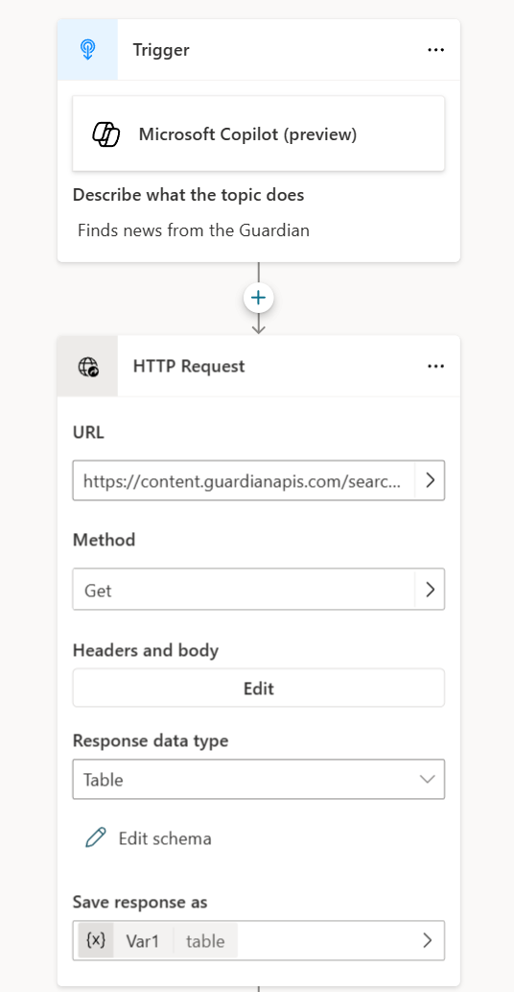
Conversational plugins
Can create custom plugins that are available for Microsoft 365 Copilot
Can use built-in flows or build custom using Power Automate
Uses a feature similiar to GPT functions to trigger the actions

Slide 39
Then the actual fun stuff....

Slide 40
Stuff that I most likely wont have time to cover....

Slide 41
LLM and the crazy development cycle
2023-01-16: Azure OpenAI released
2023-02-06: Google Bard info
2023-02-07: Bing Search with GPT released
2023-02-24: Meta introduced LLaMa
2023-03-01: OpenAI with Whisper API
2023-03-14: ChatGPT with GPTv4 lansert
2023-03-15: Midjourney v5 released
2023-03-16: Microsoft 365 Copilot announced
2023-03-21: GPTv4 i Azure OpenAI, Google Bard released
2023-03-23: ChatGPT-plugins announced
2023-04-12: Dolly 2.0 lansert
2023-04-14: AWS CodeWhisperer
2023-05-10: Microsoft 365 Copilot – Extended Preview
2023-05-15: OpenAI Plugins in ChatGPT
2023-06-13: ChatGPT Functions released
2023-07-06: ChatGPT v4 API released
2023-07-18: LLaMa2 Lansert
2023-10-16: Fine-tuning available Azure OpenAI 2023-11-01: Microsoft Copilot released
2023-11-21: Anthropic with support for 200k tokens
2023-11-29: AWS releases Q and Bedrock Agents
2024-02-15: Google releases Gemini 1.5
2021-06-11: GPT-3 Beta
2022-03-15: GPT-3 and Codex Public API
2022-06-21: Github Copilot
2022-11-30: ChatGPT released

Slide 42
How does Microsoft compare?
Features | Google | Microsoft | Amazon Web Services
LLM Service/Runtime | Vertex AI | Azure OpenAI | Bedrock
LLM Models available | PaLM, LLaMa2, Falcon, Claude2* | GPT, LLaMa2, Falcon, Databricks Dolly | Titan, Claude2, Cohere
LLM Models Code | Code-Bison | Codex
LLM Models Security | Sec-PaLM | Tbd*
LLM Models Catalog | Model Garden | Model Catalog | Model Providers
LLM Token Size FM | 32k (PaLM2) | 32k (GPT4) | 8k (Titan)
LLM Availability
LLM Integration framework | Vertex AI Extensions | Microsoft Semantic Kernel
LLM Safety filter |  | Azure AI Content Safety
LLM Fine-tuning support | Code-bison(PaLM), text-bison(PaLM) | GPT-3.5 supports Fine-tuning but not in Azure yet
LLM Agent | Vertex AI Conversation | Power Virtual agents | Bedrock Agents, Amazon Lex
gpt-ai/cloudgpt.md at main · msandbu/gpt-ai (github.com)

Slide 43
Part two
Features | Google | Microsoft | Amazon Web Services
Vector database | Cloud SQL (Pgvector), AlloyDB, Vertex AI Vector Search | Azure Cosmos DB | Amazon RDS (Pgvector)
Embedding | Text embedding API Gecko | Ada OpenAI Embedding | Titan Embeddings
Integration services - Langchain | Vertex AI, Google Search | Azure Cognitive Search
Code assistant-based AI | Duet AI | Github Copilot | Amazon Code Whisperer
Collaboration GPT | Duet AI | Microsoft Copilot
Digital Watermarking | Synthid (Image)
Security Powered LLM | Security Command Center AI | Microsoft Security Copilot
gpt-ai/cloudgpt.md at main · msandbu/gpt-ai (github.com)

Slide 44










Thank You to our sponsors !

